Slide 1

Drug testing on multi-cellular network
Deepak Lanke
PB23MTECH11003

Slide 2
Overview
Deterministic model
Optimization of parameters using Genetic Algorithm
Optimized Parameters
Calculation of Coupling co-efficients using distance matrix
Response in multi-cellular networks
Experimental Data
Objective function:
RMSE
Drug

Slide 3
Overview
Deterministic model
Optimization of parameters using Genetic Algorithm
Optimized Parameters
Calculation of Coupling co-efficients using distance matrix
Response in multi-cellular networks
Experimental Data
Objective function:
RMSE
Drug

Slide 4
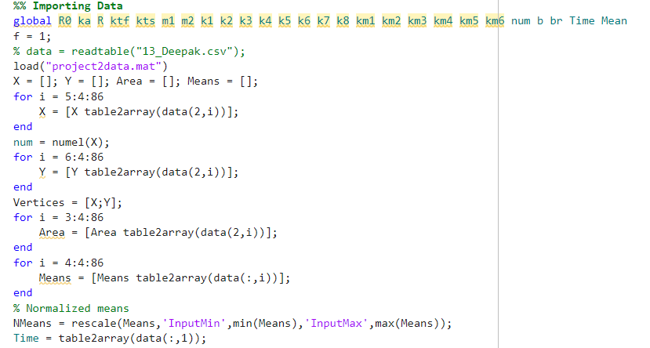
Importing

Slide 5
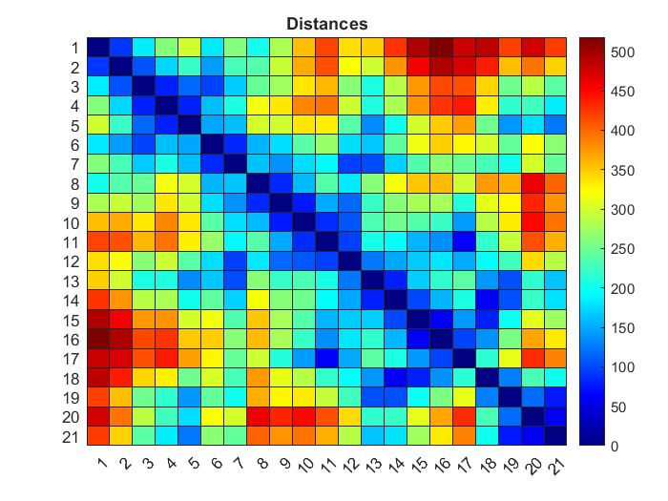
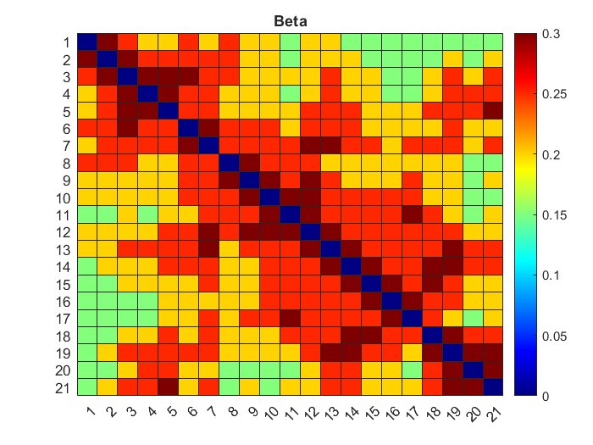

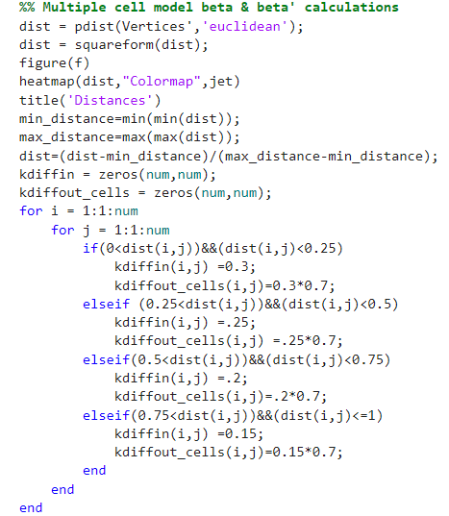
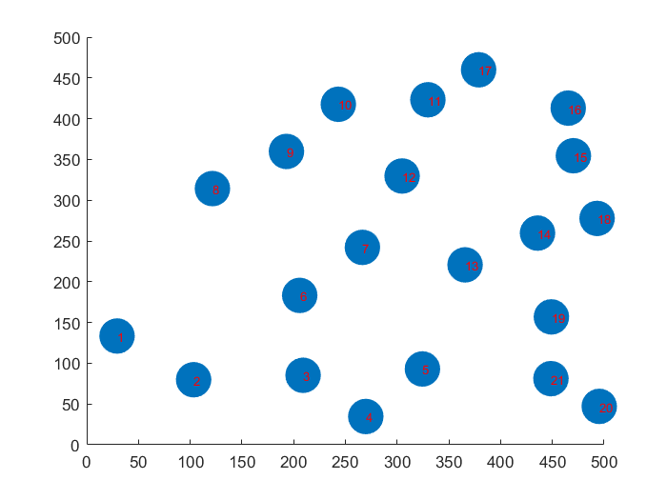
Calculation of coupling co-efficients using distance matrix

Slide 6

Deterministic model Vs Experimental

Slide 7
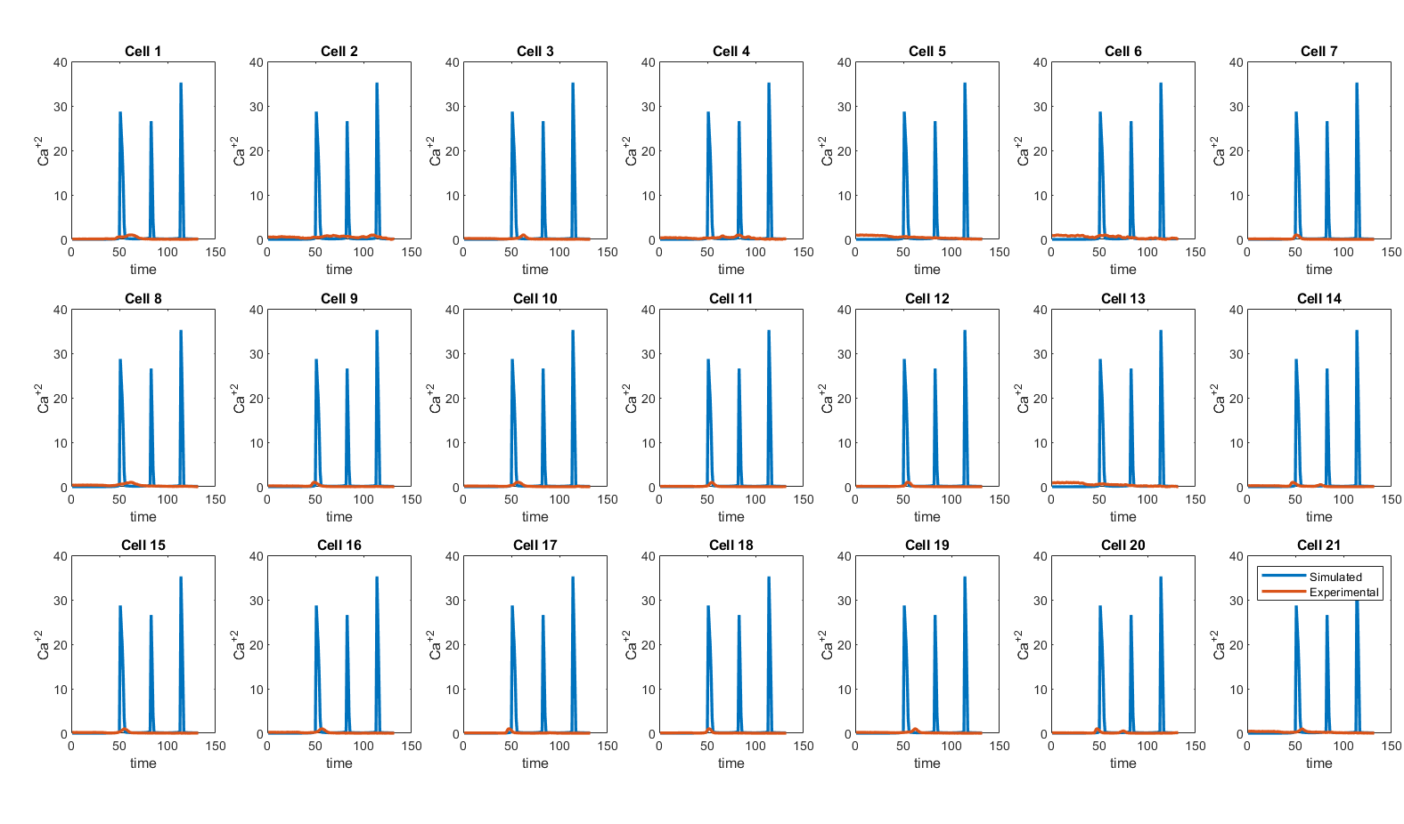

Slide 8
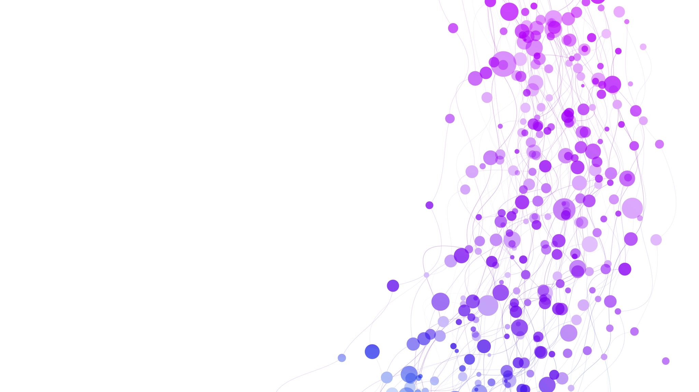
Optimization of parameters using Genetic Algorithm

Slide 9
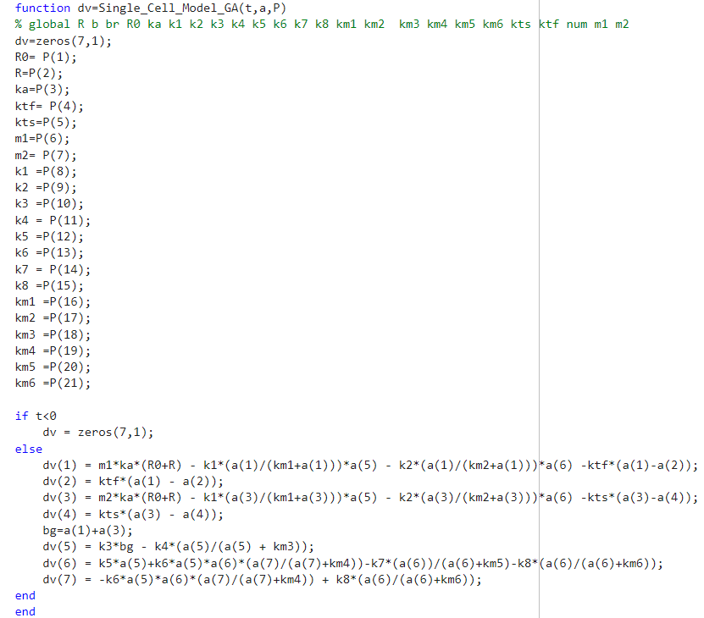

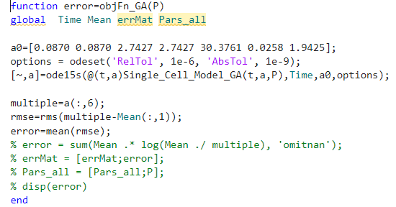

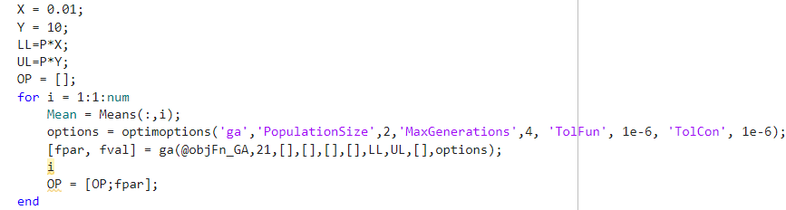

Slide 11

Parallel Computing Toolbox

Slide 12
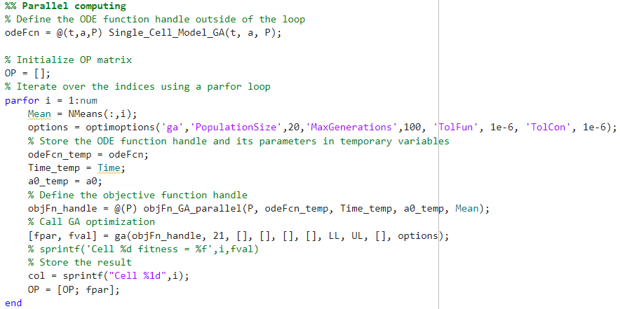

Slide 13
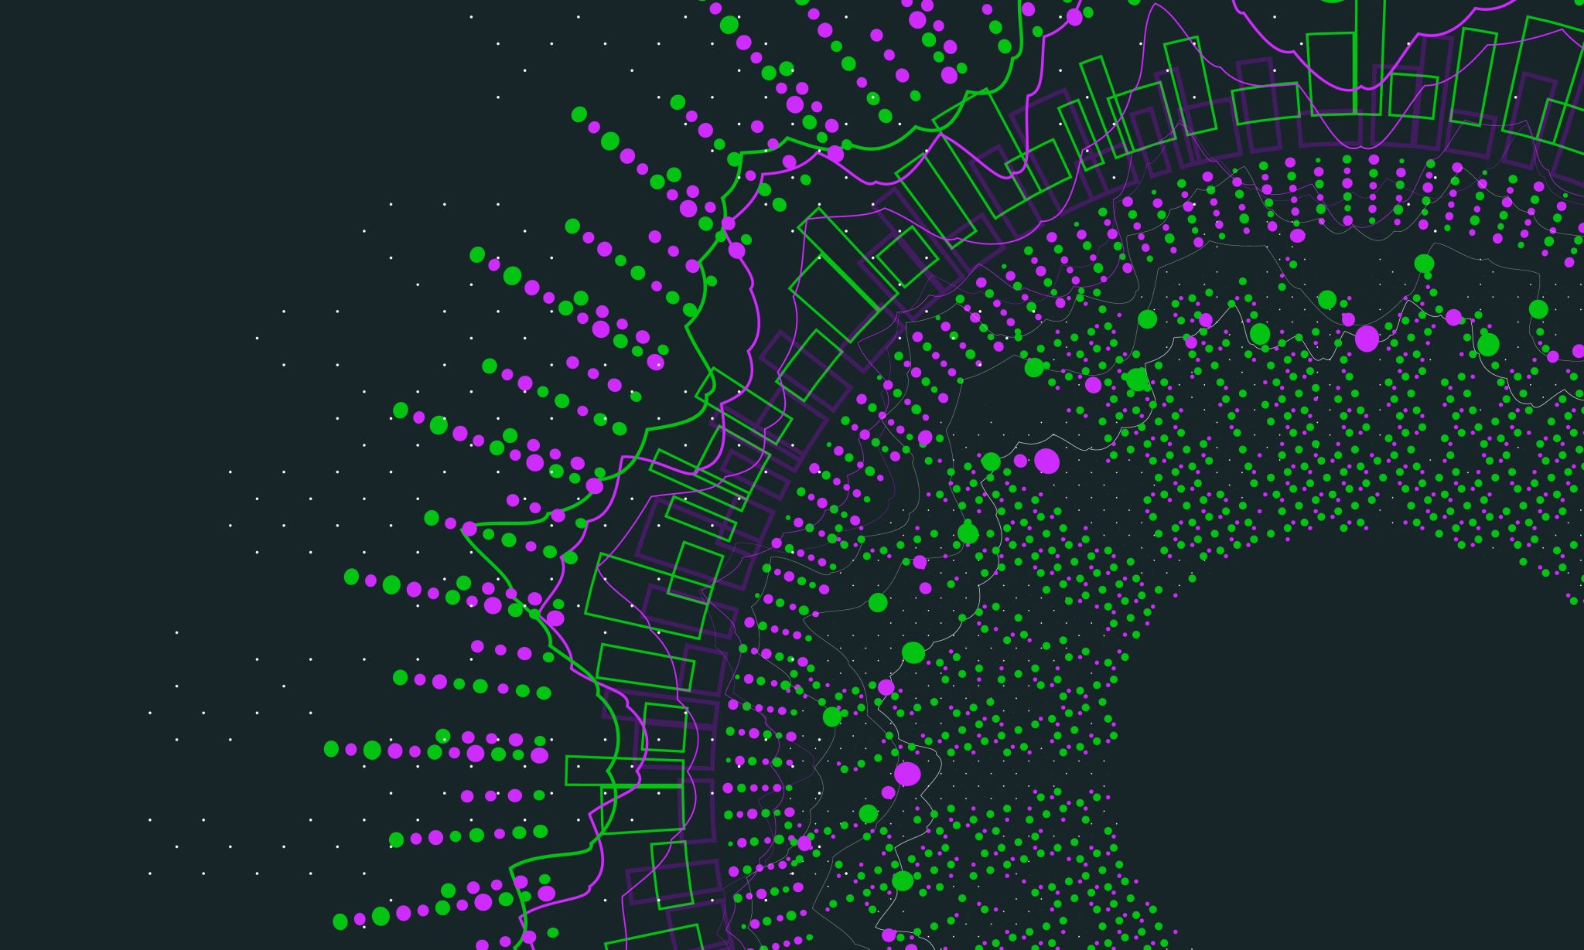
Response in multi-cellular networks

Slide 14
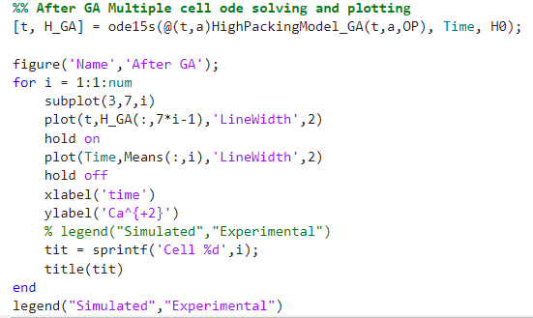
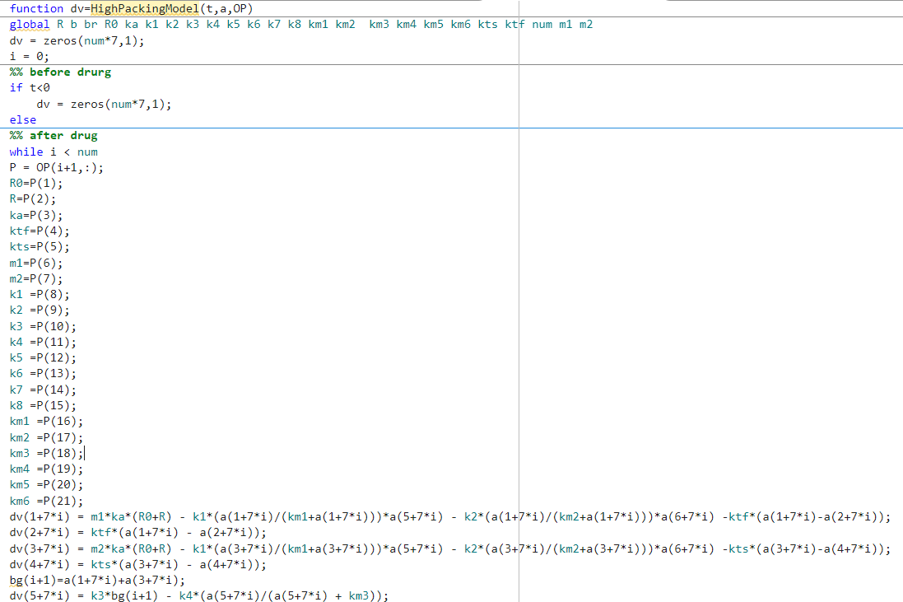
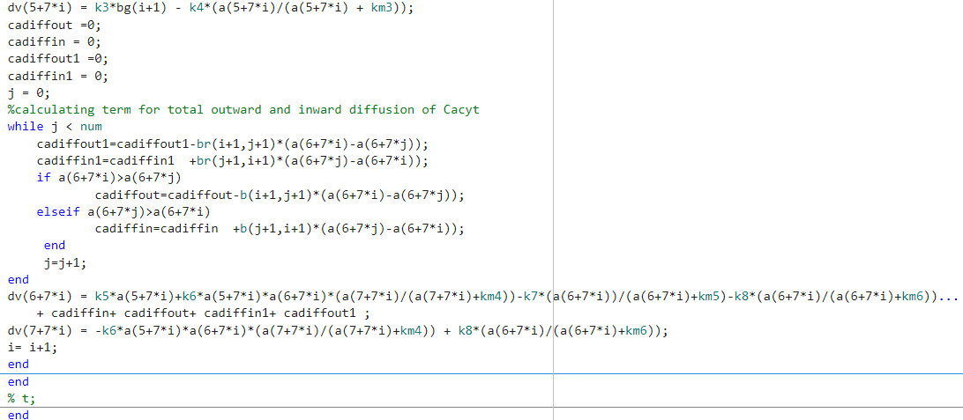

Slide 16
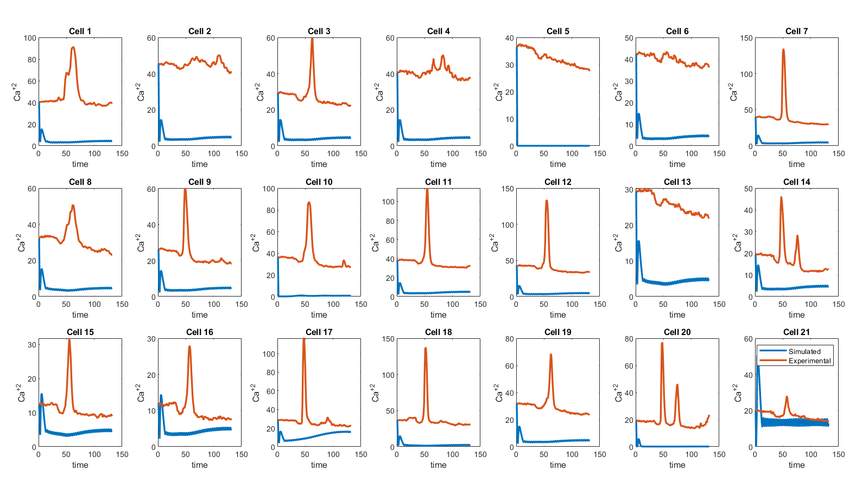
'PopulationSize',2,'MaxGenerations',4

Slide 17
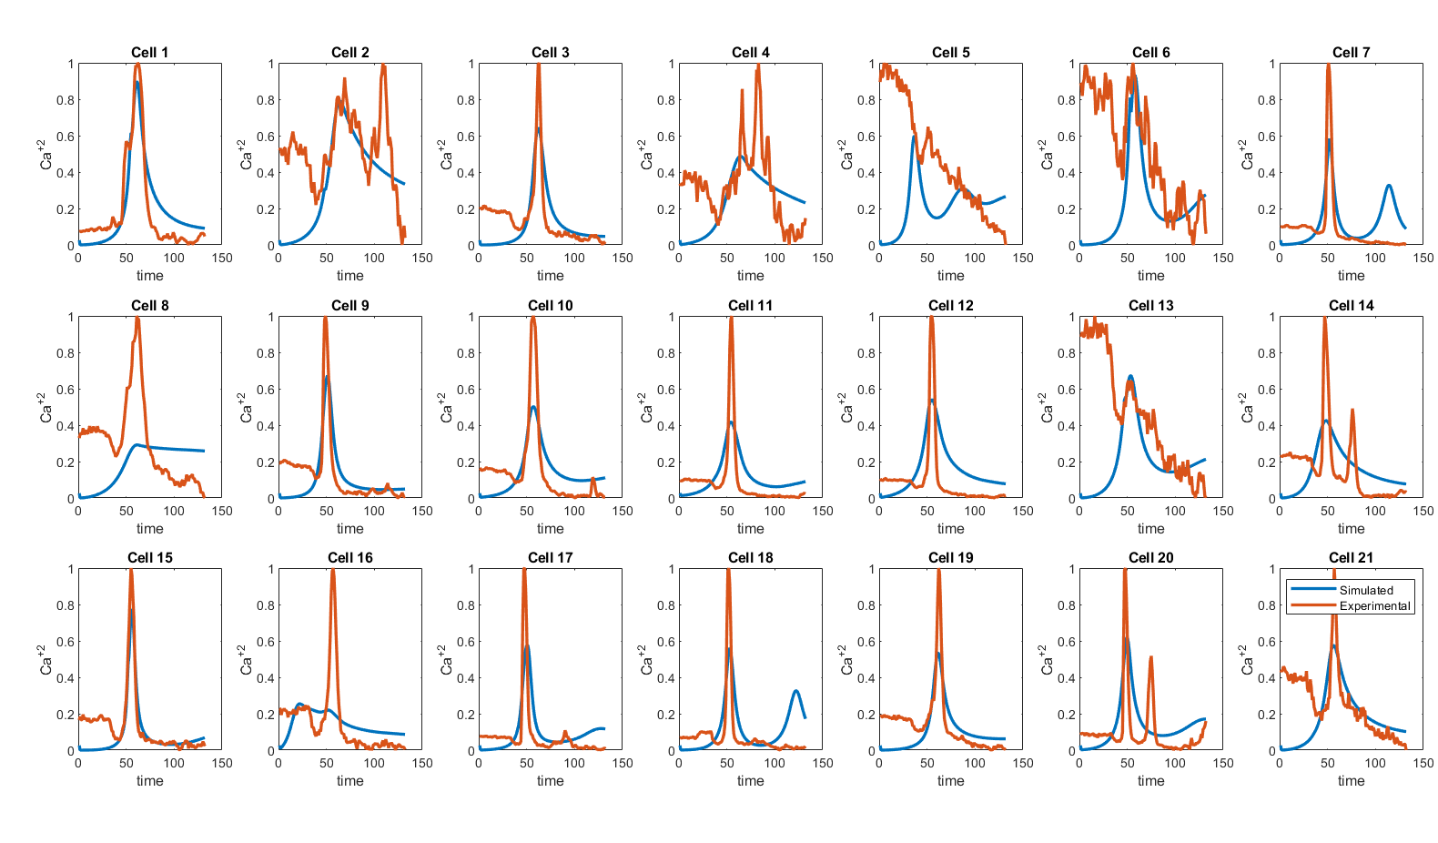
'PopulationSize’,20,'MaxGenerations’,100

Slide 18
Enhancing the code
Deterministic model
Response in multi-cellular networks
Stochastic model
Optimization of parameters using Genetic Algorithm
Optimized Parameters
Calculation of Coupling co-efficients using distance matrix
Objective function:
RMSE
Experimental Data
Objective function:
KL-Divergence
Drug

Slide 19
Enhancing the code
Deterministic model
Response in multi-cellular networks
Stochastic model
Optimization of parameters using Genetic Algorithm
Optimized Parameters
Calculation of Coupling co-efficients using distance matrix
Objective function:
RMSE
Experimental Data
Objective function:
KL-Divergence
Drug

Slide 20
Enhancing the code
Deterministic model
Response in multi-cellular networks
Stochastic model
Optimization of parameters using Genetic Algorithm
Optimized Parameters
Objective function:
RMSE
Experimental Data
Objective function:
KL-Divergence
Calculation of Coupling co-efficients
Drug

Slide 21

Thank you

